Slide 1
22C:19 Discrete Math Trees
Fall 2011
Sukumar Ghosh

Slide 2
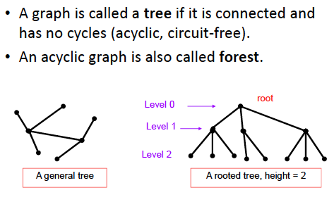
What is a tree?

Slide 3
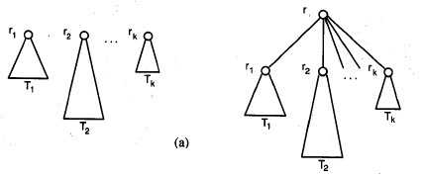
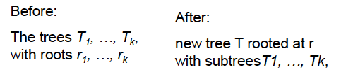
Rooted tree: recursive definition

Slide 4
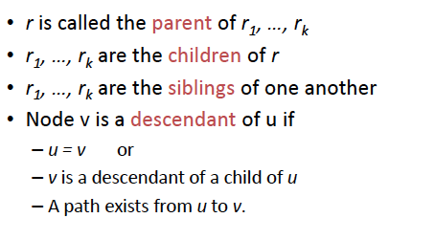
Rooted tree terminology

Slide 5
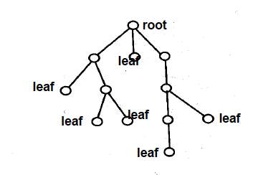
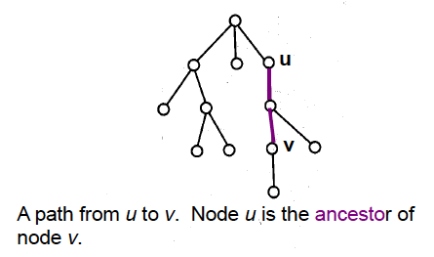
Rooted tree terminology
A subtree

Slide 6
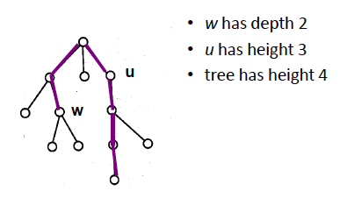
Rooted tree terminology

Slide 7
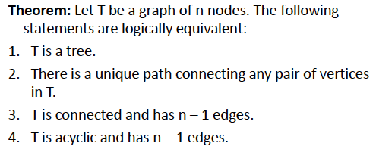
Important properties of trees

Slide 8
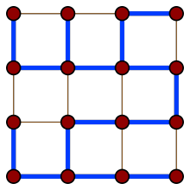
Important properties of trees
Every tree is a bipartite graph. Every tree is a planar graph.
Every connected graph G admits a spanning tree, which is a tree that contains every vertex of G and whose edges are edges of G.
Many other spanning trees exist

Slide 9
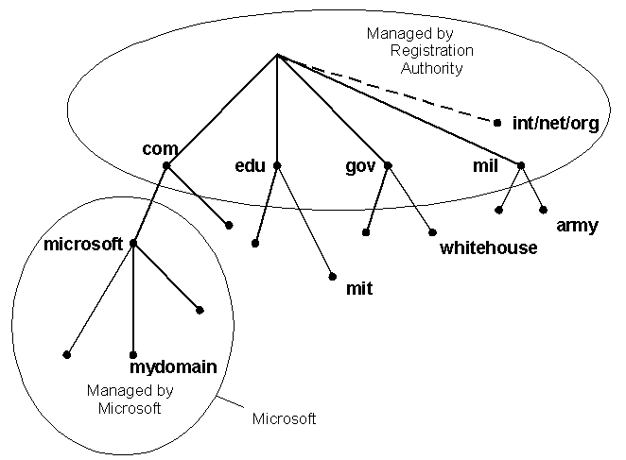
Trees as models
Domain Name System

Slide 10
Trees as models
directory
subdirectory
subdirectory
subdirectory
file
file
file
file
file
file
file
file
file
Computer File System
This tree is a ternary (3-ary) tree, since each non-leaf node has three children

Slide 11
Binary tree
Each non-leaf node has up to 2 children. If every non-leaf
node has exactly two nodes, then it becomes a full binary tree
Question.
How many edges does a full binary tree with n nodes have?
How many edges does a full m-ary tree with n nodes have?

Slide 12
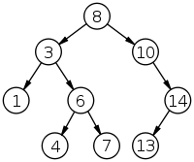
Binary search tree
Ordered binary tree. For any non-leaf node
The left subtree contains the lower keys.
The right subtree contains the higher keys.
How can you search an item? How many steps
Does each search take?
A binary search tree of size 9
and depth 3, with root 8 and
leaves 1, 4, 7 and 13

Slide 13
Huffman coding
Consider the problem of coding the letters of the English
alphabet using bit-strings. One easy solution is to use
5 bits for each letter (2⁵ > 26). Another such example is
The ASCII code. These are static codes, and do not make
use of the frequency of usage of the letters to reduce the
size of the bit string.
One method of reducing the size of the bit pattern is to use
prefix codes.

Slide 14
Prefix codes
0
1
In typical English texts, e is
most frequent, and then come
a, l, n, s, t … Using the prefix tree,
e = 0, a = 10, l= 110, n = 1110 etc
Such techniques are popular for
data compression purposes. The
resulting code is a variable-length
code.
e
0
1
a
0
1
l
0
1
n
1
0
s
t

Slide 15
Huffman codes
Another data compression technique first developed
By David Huffman when he was a graduate student
at MIT in 1951. (see pp. 763-764 of the textbook)

Slide 16
Game trees
How to visualize the moves in a game as a tree?
How does Deep Blue play chess?
We will discuss this in the class

